Slide 1
Pemrograman Web 4. Penanganan Form
Joko Suntoro
jokosuntoro@usm.ac.id
SMS/Telp: 0822-4236-9670
WA/Telegram: 085-641-970-170
http://jokosuntoro.com

Slide 2

Joko Suntoro
SDN Pandean Lamper 03 Semarang (1995-2001)
SMPN 32 Semarang (2001-2004)
SMA Institut Indonesia Semarang (2004-2007)
S1 Teknik Informatika Universitas Semarang (2010-2015)
S2 Teknik Informatika Universitas Dian Nuswantoro (2015-2016)
Tim Operasi dan Teknik, Domestic Gas PT Pertamina (Persero) (2008-sekarang)
Peneliti dan Reviewer di Romi Satria Wahono (RSW) Intelligent System Research Group
Bidang Penelitian: Data Mining, Intelligent System dan Machine Learning

Slide 3
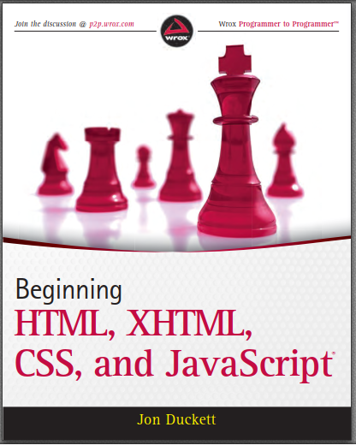
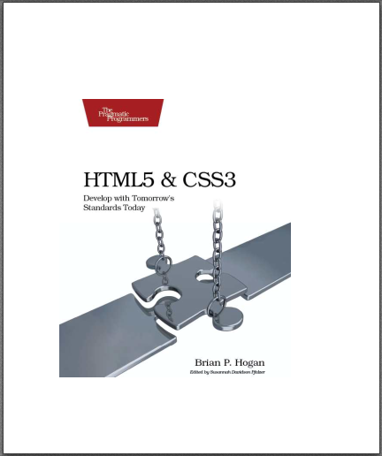
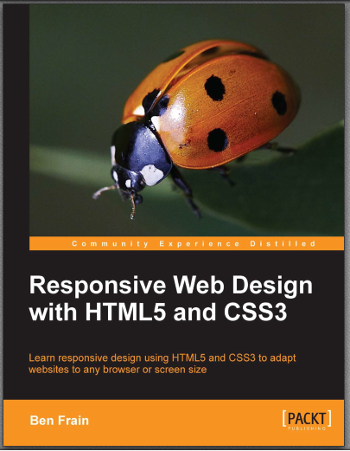


Textbooks
Notes:
Ducket, Frain, Hogan, Shenoy

Slide 4
4.1 Pengenalan Form

Slide 5
Element Form
Untuk membuat form pada halaman web digunakan elemen <form>…</form>
Every <form> element should carry at least two attributes: action and method
The action attribute indicates what happens to the data when the form is submitted
The method attribute can be sent to the server in two ways:
The get method, which sends data as part of the URL
The post method, which hide data in something known as the HTTP headers

Slide 6
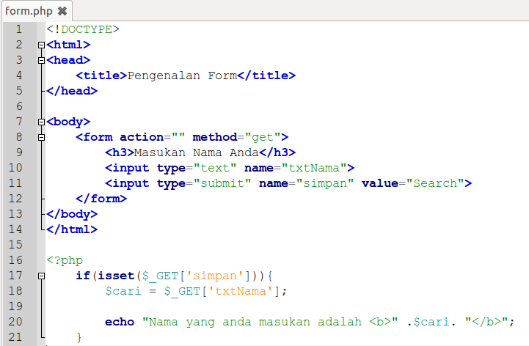
Contoh Script Form

Slide 7
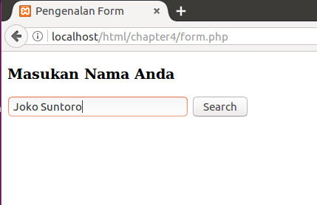
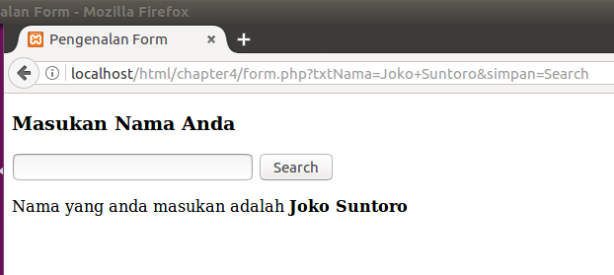
Hasil di Browser

Slide 8
4.2 Bekerja dengan Form

Slide 9
4.2.1 Form Input dan Password

Slide 10
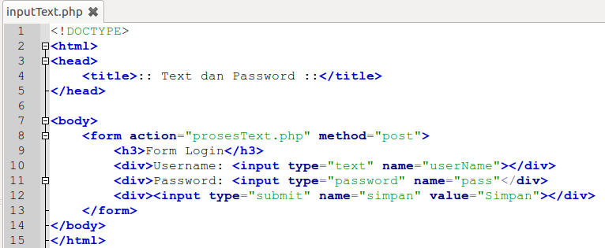
1. Form Input PHP (Text dan Password)
Source code: inputText.php

Slide 11
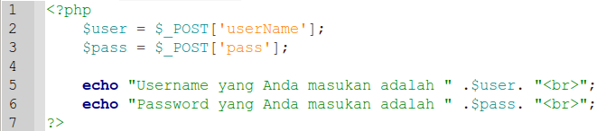
2. Proses PHP (Text dan Password)
Source code: prosesText.php

Slide 12
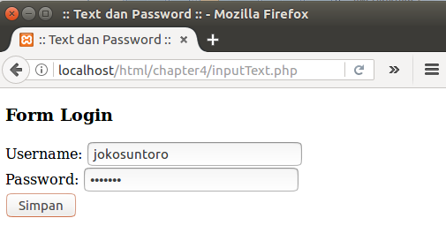
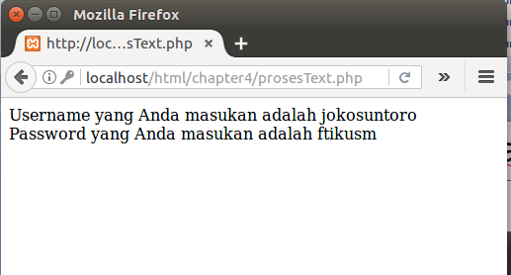
3. Output (Text dan Password)
Hasil Browser

Slide 13
4.2.2 Form Input Combobox

Slide 14
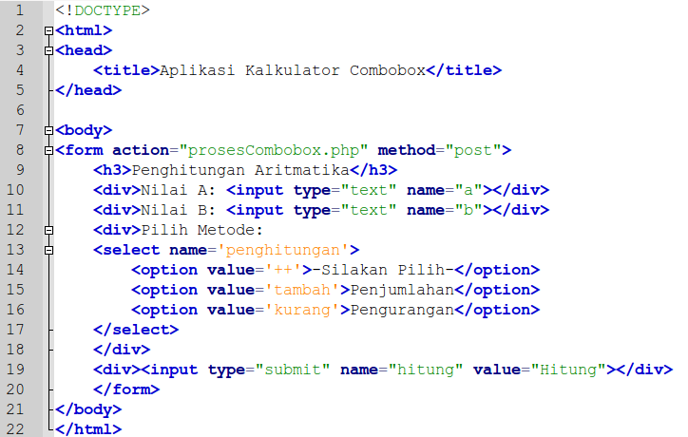
1. Form Input PHP (Combobox)
Combobox.php

Slide 15
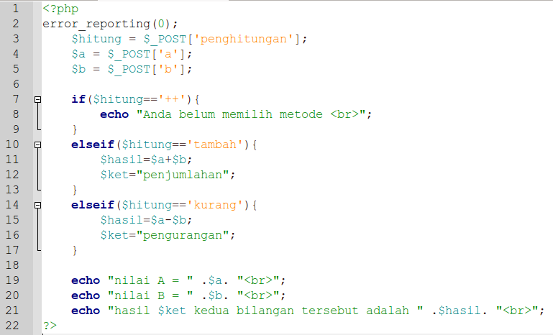
2. Proses PHP (Combobox)
prosesCombobox.php

Slide 16
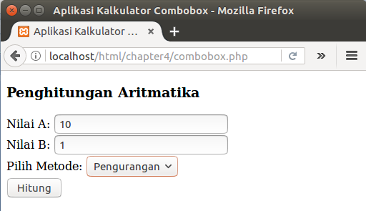
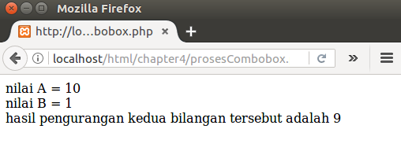
3. Output (Combobox)

Slide 17
4.2.3 Form Input Checkbox

Slide 18
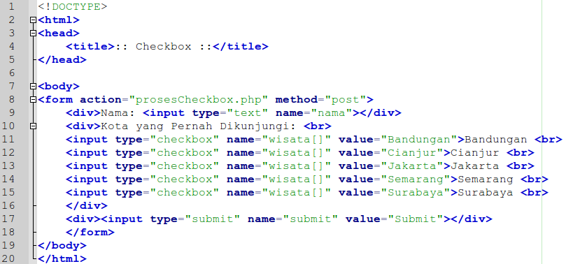
1. Form Input PHP (Checkbox)
checkbox.php

Slide 19
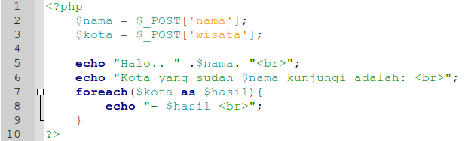
2. Proses PHP (Checkbox)
prosesCheckbox.php

Slide 20
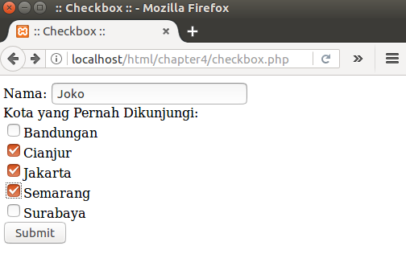
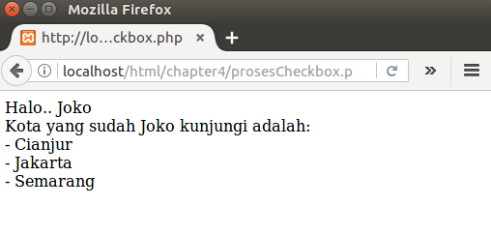
3. Output (Checkbox)

Slide 21
4.2.4 Form Input Radio Button

Slide 22
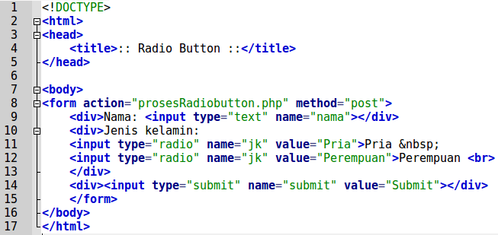
1. Form Input PHP (Radiobutton)
radiobutton.php

Slide 23
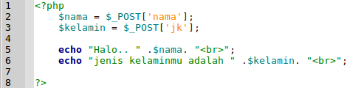
2. Proses PHP (Radiobutton)
prosesRadiobutton.php

Slide 24
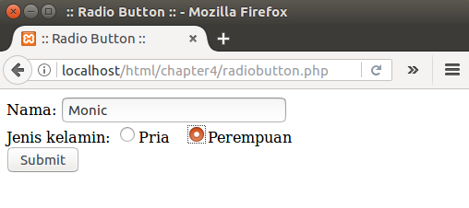
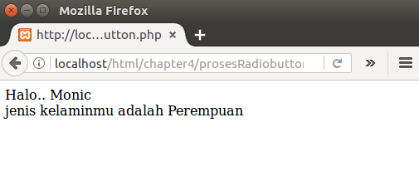
3. Output (Radiobutton)

Slide 25
4.2.5 Form Input Text Area

Slide 26
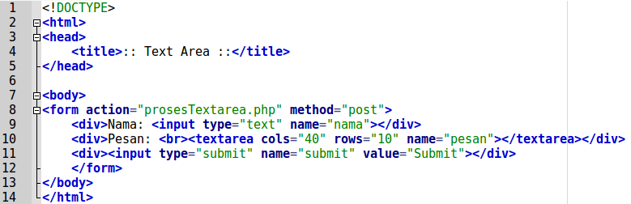
1. Form Input PHP (Text Area)
textarea.php

Slide 27
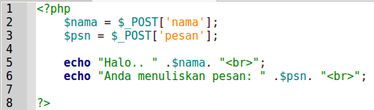
2. Proses PHP (Text Area)
prosesTextarea.php

Slide 28
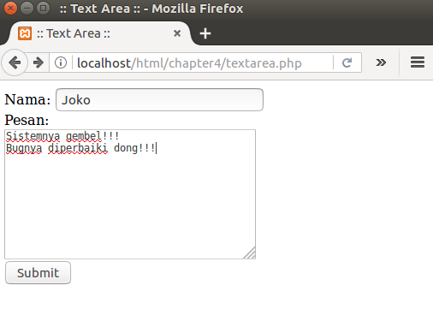
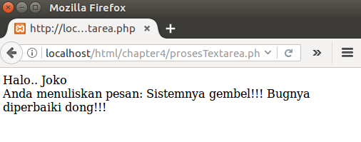
3. Output (Text Area)

Slide 29
Referensi
Duckett, J. (2010). Begining HTML, XHTML, CSS and JavaScript. (C. Ullman, Ed.). Canada: Willey Publishing, Inc.
Frain, B. (2013). Responsive Web Design with HTML5 and CSS3. (R. de Jongh, Ed.). Birmingham: Packt Publishing Ltd.
Hogan, B. P. (2010). HTML5 and CSS3 Develop with Tomorrow’s Standards Today. United States of America: Pragmatic Programmer, LLC.
Shenoy, A. (2014a). Thinking in CSS. (S. Sukumaran, Ed.). Birmingham: Packt Publishing Ltd.
Shenoy, A. (2014b). Thinking in HTML. (K. Narayanan, Ed.). Brimingham: Packt Publishing Ltd.
Wang, P., & Katila, S. (2003). An introduction to Web design and programming. Brooks-Cole.

